Slide 1
Prolog Principles
Lecture P4 – CS 352

Slide 2
Principle of Logic Programs
A logic program is a collection of axioms from which theorems can be proven
A program is a theorem
The language (compiler/interpreter) tries to use a collection of axioms and inference steps to satisfy the goal
Axiom are written in a standard form known as Horn clauses
A Horn clause consists of a consequent (head H) and a body (terms Bi)
H :- B1, B2,…, Bn
Semantics: when all Bi are true, we conclude H is true

Slide 3
Resolution
The derivation of new clauses is known as resolution
The logic programming system combines existing clauses to generate new clauses
Example:
C :- A, B
D :- C
D :- A, B
A and B imply C
A and B imply C and C implies D
➔ A and B imply D

Slide 4
Principle of Resolution
Principle of Resolution: basis of Prolog execution
If C₁ and C₂ are Horn clauses and the head of C₁ matches one of the terms in the body of C₂, then we can replace the term in C₂ with the body of C₁
Example
C₁: likes(sam,Food) :- indian(Food), mild(Food).
C₂: indian(dahl).
C₃: mild(dahl).
Can replace the first and the second terms in C₁ by C₂ and C₃ (after instantiating variable Food to dahl)
Therefore, likes(sam, dahl) can be proved

Slide 5
Instantiation, Matching and Unification
instantiation is the way in which variables acquire a value.
bmi(W,H,B) :- B is W / (H * H) * 703.
bmi(100,52,B).
matching compares two items. Matching either succeeds or fails.
likes(mary, book).
likes(john, wine).
?- likes(mary, wine). %no match, fail
?-likes(john, wine). %match, succeed
?- likes(X, book). %instantiation + match

Slide 6
Unification
Prolog associates variables and values using a process known as unification
Unification rules
A constant unifies only with itself
Two structures unify if and only if they have the same functor (i.e. structure) and the same number of arguments, and the corresponding arguments unify recursively
A variable unifies to with anything

Slide 7
Equality
Equality is defined as unifiability
An equality goal is using an infix predicate =
For instance,
?- dahl = dahl.
Yes
?- dahl = curry.
No
?- likes(Person, dahl) = likes(sam, Food).
Person = sam
Food = dahl ;
No
?- likes(Person, curry) = likes(sam, Food).
Person = sam
Food = curry ;
No

Slide 8
Equality
What is the results of
?- likes(Person, Food) = likes(sam, Food).
Person = sam
Food = _G158 ;
No
Internal Representation for an
uninstantiated variable
Any instantiation proves the equality

Slide 9
Execution Order
Prolog searches for a resolution sequence that satisfies the goal
In order to satisfy the logical predicate, we can imagine two search strategies:
Forward chaining, derived the goal from the axioms
Backward chaining, start with the goal and attempt to resolve them working backwards
Backward chaining is usually more efficient, so it is the mechanism underlying the execution of Prolog programs
Forward chaining is more efficient when the number of facts is small and the number of rules is very large

Slide 10
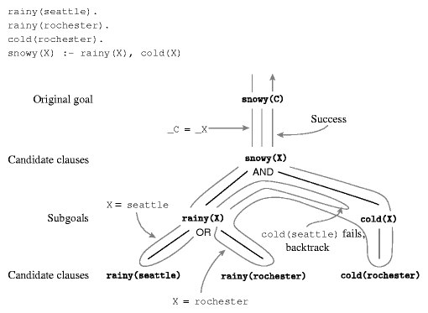
Backward Chaining in Prolog
Backward chaining follows a classic depth-first backtracking algorithm
Example
Goal:
?-Snowy(C)

Slide 11
Depth-first backtracking
The search for a resolution is ordered and depth-first
The behavior of the interpreter is predictable
Ordering is fundamental in recursion
Recursion is again the basic computational technique, as it was in functional languages
Inappropriate ordering of the terms may result in non-terminating resolutions (infinite regression)
For example: Graph
edge(a,b). edge(b, c). edge(c, d).
edge(d,e). edge(b, e). edge(d, f).
path(X, X).
path(X, Y) :- edge(Z, Y), path(X, Z).
Correct

Slide 12
Depth-first backtracking
The search for a resolution is ordered and depth-first
The behavior of the interpreter is predictable
Ordering is fundamental in recursion
Recursion is again the basic computational technique, as it was in functional languages
Inappropriate ordering of the terms may result in non-terminating resolutions (infinite regression)
For example: Graph
edge(a,b). edge(b, c). edge(c, d).
edge(d,e). edge(b, e). edge(d, f).
path(X, Y) :- path(X, Z), edge(Z, Y).
path(X, X).
Incorrect

Slide 13
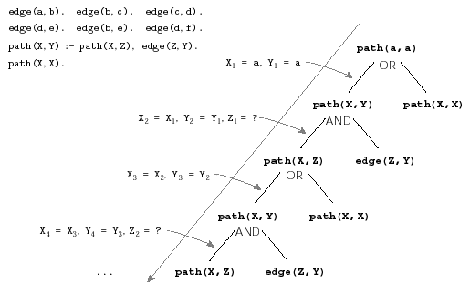
Infinite Regression
Goal

Slide 14
Examples
Genealogy
http://ktiml.mff.cuni.cz/~bartak/prolog/genealogy.html
Data structures and arithmetic
Prolog has an arithmetic functor is that unifies arithmetic values
E.g. is (X, 1+2), X is 1+2
Dates example
http://ktiml.mff.cuni.cz/~bartak/prolog/basic_struct.html

Slide 15
References
Felix Hernandez-Campos at UNC Chapel Hill Programming Languages course materials
Prolog Programming by ROMAN BARTÁK
http://ktiml.mff.cuni.cz/~bartak/prolog/index.html

